Slide 1
Prediction of default Credit Card Clients
CS 513 Knowledge Discovery in Database

Slide 2
Introduction
In recent years, in order to increase market share, some card-issuing banks over-issued credit cards to unqualified applicants. At the same time, most cardholders, irrespective of their repayment ability, overused credit card for consumption and consequently accumulated heavy credit card debts. This crisis caused a blow to consumer finance confidence, and is now a big challenge for both banks and cardholders.
Aim:
This project aims to study different demographic and financial variables of credit card clients in Taiwan from April 2005 to September 2005 as our predictors, and the fact that such clients default or not as our outcome variable to answer the following research question

Slide 3
Objectives, Requirements and
Accomplishments
To develop a well defined Financial System
Thus focus more on the risk prediction rather than crisis management
To reduce the damage and uncertainty by predicting the credit risk and avoid such clients in the future

Slide 4
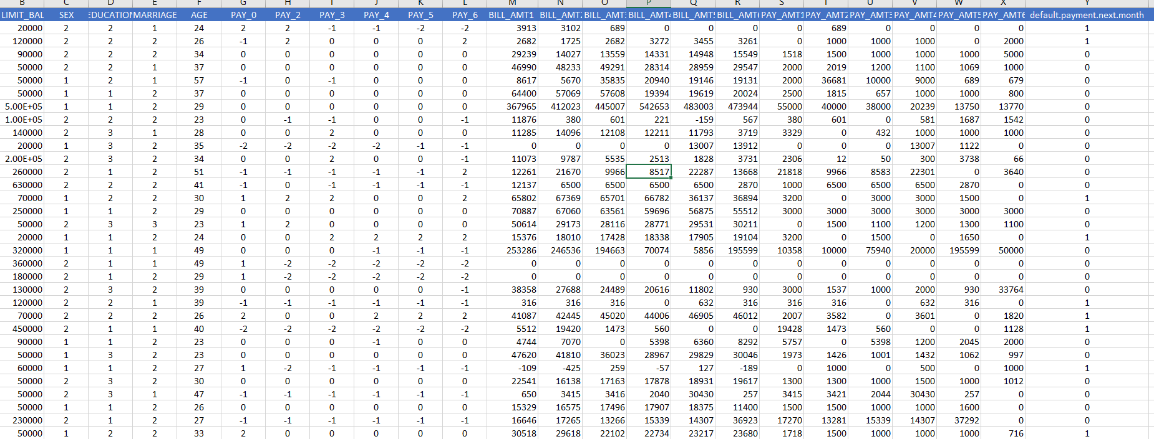
Data understanding Phase:

Slide 5
Data understanding Phase:
LIMIT_BAL: Amount of the given credit (NT dollar): it includes both the individual consumer credit and his/her family (supplementary) credit.
SEX: Gender (1 = male; 2 = female).
EDUCATION: Education (1 = graduate school; 2 = university; 3 = high school; 4 = others).
Marriage: Marital status (1 = married; 2 = single; 3 = others).
AGE: Age (year).
PAY 0- PAY6 : History of past payment. We tracked the past monthly payment records (from April to September, 2005) as follows: X6 = the repayment status in September, 2005; X7 = the repayment status in August, 2005; . . .;X11 = the repayment status in April, 2005. The measurement scale for the repayment status is: -1 = pay duly; 1 = payment delay for one month; 2 = payment delay for two months; . . .; 8 = payment delay for eight months; 9 = payment delay for nine months and above.
BILL AMT 1- BILL AMT6: Amount of bill statement (NT dollar). X12 = amount of bill statement in September, 2005; X13 = amount of bill statement in August, 2005; . . .; X17 = amount of bill statement in April, 2005.
PAT AMT 1 – PAY AMT 6: Amount of previous payment (NT dollar). X18 = amount paid in September, 2005; X19 = amount paid in August, 2005; . . .;X23 = amount paid in April, 2005.

Slide 6
Data cleaning:
We observe that the Education field has values 0, 5, 6 which are invalid and thus must be removed
Marriage field had 0 and 3 values which were invalid
No missing values were found

Slide 7
